Slide 1
Connected Experiences
A Developer's Guide to Windows 10 Andy & Jerry

Slide 2
User Identity in Windows 10
Roaming Settings/Roaming Folder for both MSA and AAD identities
State stored in Cloud services

Slide 3
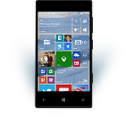
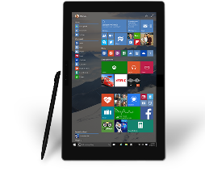
Evolution of Mobile Experiences
Reaching your customers in new and unique ways
Mobile “Devices” led to revolutionary Experiences
“Bring the experience with you”
Came with many constraints (small screen, battery, etc.)
Notes:
Every developer wants to grow their install base and reach more customers. The growth of mobile devices has led to a set of revolutionary experiences allowing developers to reach their customers in new and unique ways .
However, up until now, mobility has been attached to “mobile devices” – or devices that you carry on your person like a phone or tablet. You sort of “bring the experience with you”. However, this is a very constrained experience as the screens are small, battery are limiting, and sharing the experience is typically challenging. How many times have you tried to show everyone in the room a photo? You have to pass around your phone or have everyone look over your shoulder.

Slide 4
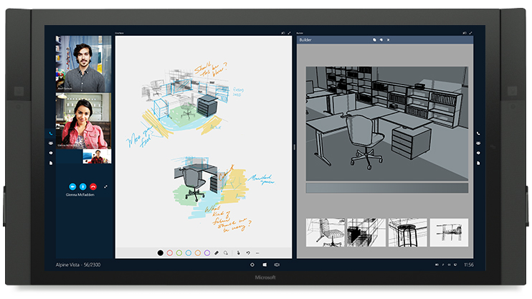
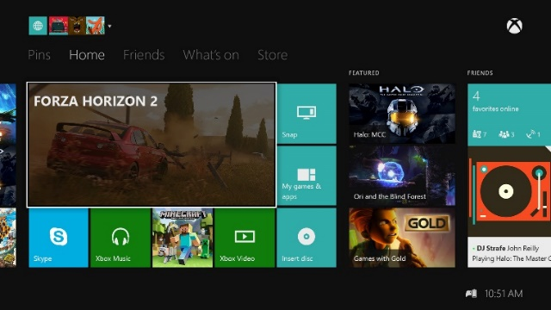
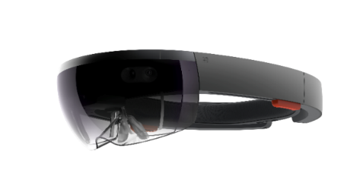

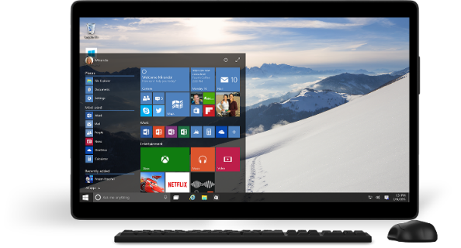
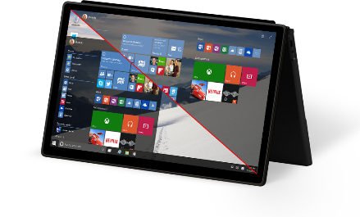
Mobile Experiences - not just mobile devices
The Experience you want on the device you want
User is the center of the experience, not the device.
Available on the right device at the right time
Input model optimized for the experience.
Enabling Mobile Experiences with Universal Apps
User
Notes:
Increasingly, end users are itching to break out of these constraints and have truly mobile EXPERIENCES where they can bring the experience with them to whatever device is most convenient or productive to use.
People want to be at the center of the experience – not their device. If there is a big screen and you want to share an experience with a group – you should be able to bring the experience to that screen.
It also is not just about different screen sizes, but in many cases these devices also happen to have different interaction models, whether it be touch, mouse & keyboard, game controller or even pen. For example I find myself wanting to start with touch to interact with my device but when I need to be more productive or do something more precise, like when I was editing these slides, I moved to using both my mouse and my keyboard. I also find that when I wanted to annotate or give notes, that it felt most natural to use my pen.
End users want their experiences available on the right device at the right time – allowing them the simplicity of sharing and collaboration.
With Windows 10 we are blazing a new path forward for MOBILE EXPERIENCES – breaking out of the limited box of just “mobile devices” and all of this is powered with Universal Apps as they can target and run on all devices in the Windows ecosystem.

Slide 5
Create shared mobile experiences whatever the device

Slide 6
Roaming and User Identity in Windows 10

Slide 7



Mobility and the cloud is the new normal
66%
25%
33%
of employees use personal devices for work purposes.*
of all software will be available on a SaaS delivery by 2020.**
of employees that typically work on employer premises, also frequently work away from their desks.***
*CEB The Future of Corporate ITL: 203-2017. 2013.
**Forrester Application Adoption Trends: The Rise Of SaaS
***CEB IT Impact Report: Five Key Findings on Driving Employee Productivity Q1 2014.

Slide 8
First.. A bit about User Identity…
In 8.1, each user had to have a Microsoft Account (MSA) to install modern apps from the Windows Store
Requirement for personal MSA did not sit well with enterprises

Slide 9
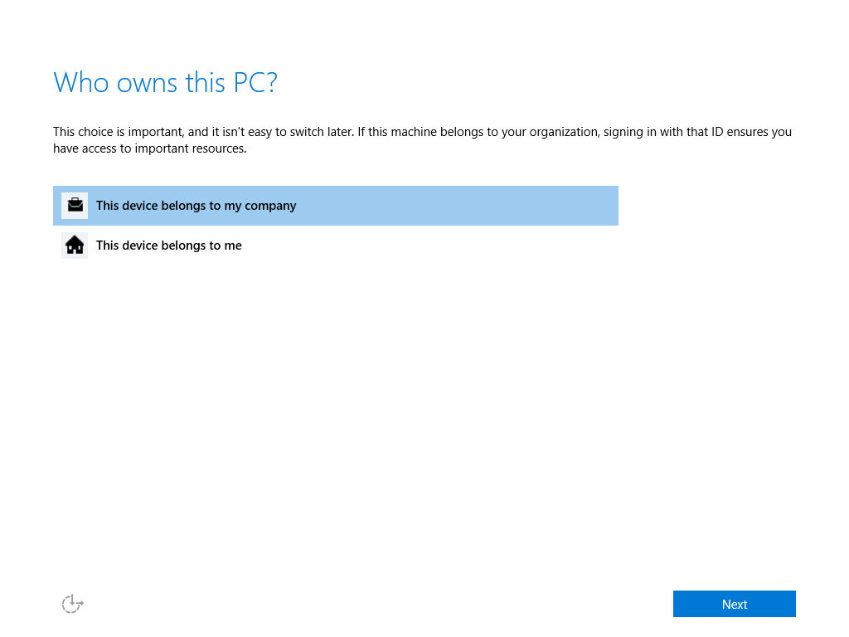
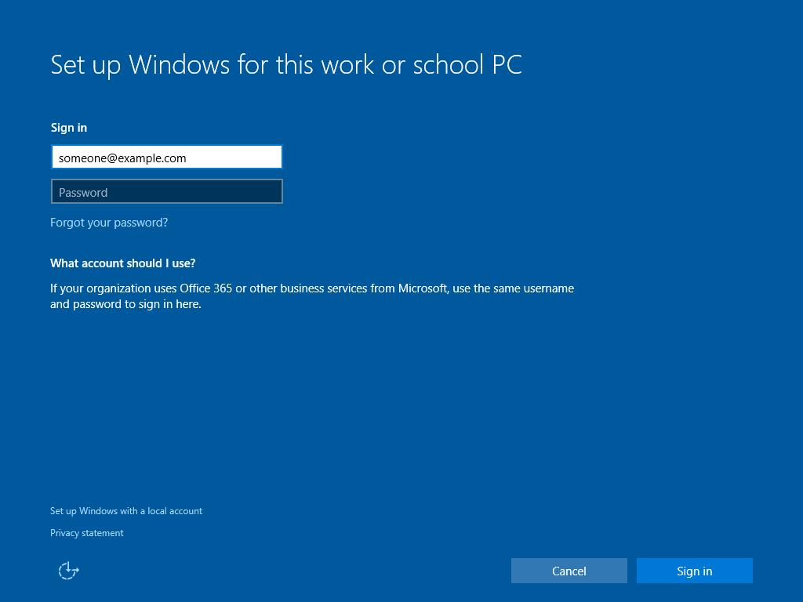
In Windows 10 Setup…
You have an important choice:

Slide 10
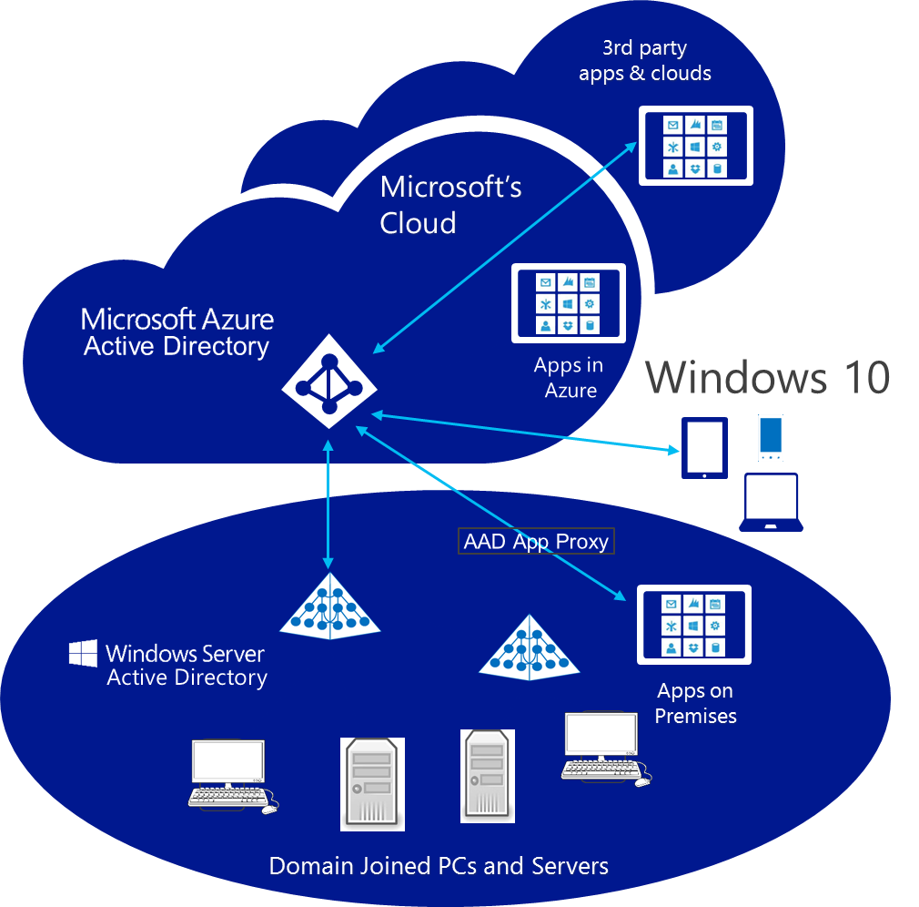
Windows 10 takes a bold step forward…
Windows connects with AD and AAD too!
Log on to Windows with work accounts
Access apps & resources in either environment
Device and app state roams
Install apps from the Business Store Portal
Devices are automatically enrolled in MDM
IT can use Conditional Access
Notes:
Company owned Windows 10 devices can be joined to the org’s AD domain on-prem or the Azure AD tenant in the cloud.
Users log on to Windows with work accounts and seamlessly access apps and resources in either environment.
Device and app state is roamed, ensuring a consistent experience for employees. They will also be able to backup/restore from the cloud and install authorized apps from the store.
Devices are automatically enrolled in MDM. IT can use Conditional Access to verify device health before providing access to corporate resources.

Slide 11
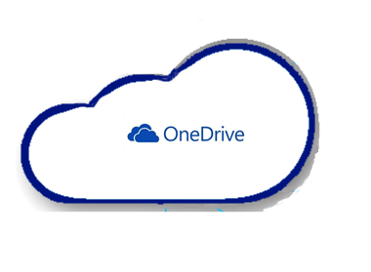
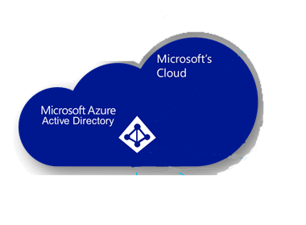

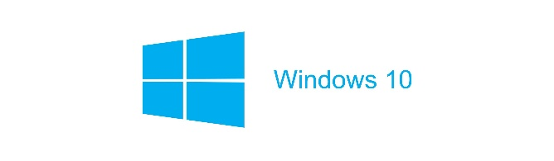
OS Settings Roaming in Windows 10
OS settings roam to OneDrive for MSA identity
OS settings roam to OneDrive for Business for AAD identity
OS settings (personalization, accessibility, language, Spartan/IE support, credentials vault, etc) roam with the primary account
Notes:
OS settings roam with primary account
App state roams with the identity used to acquire the app
For example, with BYOD the OS settings (personalization, accessibility, language, Spartan/IE support, credvault, etc) would roam with MSA.

Slide 12
App Settings Roaming in Windows 10
App settings roam to OneDrive for apps acquired from the consumer store
App settings roam to OneDrive for Business for apps acquired from the corporate store
Whether the primary account is AAD or MSA, user can acquire apps from both the consumer and (if available) the corporate store
Notes:
App state roams with the identity used to acquire the app
Any applications purchased via the consumer store would roam to MSA/OneDrive and any applications purchased from the corporate store would roam to AAD/Azure.
There are absolutely no changes required in the underlying data model to support AAD roaming. The magic happens at the “identity” level.
You can’t get OS settings or an application to roam to both clouds at the same time.

Slide 13
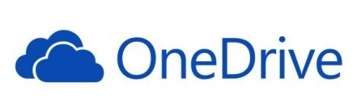

Roaming Data
Other clients are notified of updated data via Windows Notification Service. If app is running when sync occurs, an event is raised.
Sync engine transfers data periodically based on triggers (user idle, battery, network, etc.)
/
PFN 12345
Roaming
folder
Roaming
settings
OneDrive (MSA identity) stores up to 100kb of roaming data per app (not included in user quota). If app exceeds the limit, sync stops.
UWP app – PFN 12345
UWP app – PFN 12345
Roaming
Local
Temp
Temp
Local
Roaming
App writes data using standard file/settings APIs.
Notes:
Note again that the roaming data isn't cleared out instantly when you uninstall all the apps, and is held for a reasonable time (like a month, but the exact time is not guaranteed).

Slide 14
Roaming Data APIs

Slide 15
Using the Roaming settings
The RoamingSettings are exposed as a dictionary into which an application can save data
Note: On Windows Desktop, there is a special HighPriority key. This has no effect on Windows Mobile.
Windows.Storage.ApplicationDataContainer roamingSettings =
Windows.Storage.ApplicationData.Current.RoamingSettings;
roamingSettings.Values["userName"] = name.Text; var composite = new Windows.Storage.ApplicationDataCompositeValue(); composite["intVal"] = 1; composite["strVal"] = "string"; roamingSettings.Values["exampleCompositeSetting"] = composite;

Slide 16
Reading the Roaming settings
Query the roaming settings by using the key name
Windows.Storage.ApplicationDataContainer roamingSettings =
Windows.Storage.ApplicationData.Current.RoamingSettings;
if (roamingSettings.Values.ContainsKey("userName"))
{
name.Text = roamingSettings.Values["userName"].ToString();
}

Slide 17
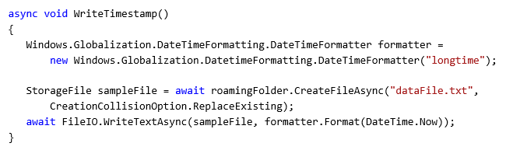
Roaming Folder
Use the roaming app data store to read/write files and folders

Slide 18
DataChanged notification
The DataChanged event fires when the roaming data has changed
Windows.Storage.ApplicationData.Current.DataChanged += Current_DataChanged;
...
void Current_DataChanged(ApplicationData sender, object args)
{
// Refresh your settings...
}
The event is only fired if the application is active at the time of the change
You should still load up all your data when your app starts

Slide 19
Debugging apps using Roaming Data
Developers can install an application on multiple unlocked devices
Locking a developer device will trigger the synchronisation
If you have problems:
Make sure that files are closed correctly
Make sure that the devices are running the same version of the application

Slide 20
Roaming Data
demo

Slide 21
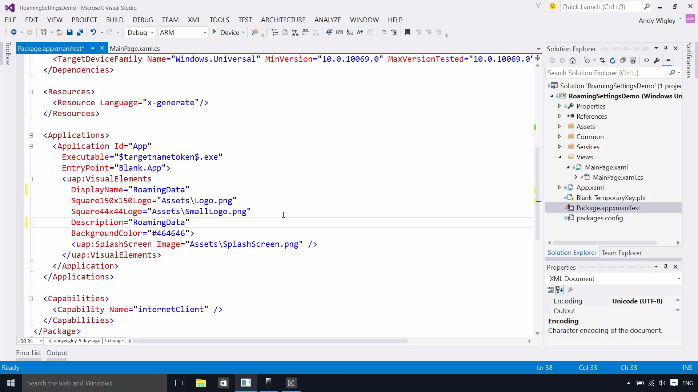

Slide 22
Tips on using roaming data
Use roaming folder and roaming settings in the same way as local folder and settings
HighPriority setting is available on Windows Desktop for quick sync, but has no effect on Windows Mobile
Good for app customisation settings, most recent activity, partially completed work
Bad for synchronising large amounts of data or “instant syncing” scenarios
Last writer wins
Data deleted from cloud if app not used for “a period of time” (~30 days)

Slide 23
Do not use Roaming Data as a general purpose data syncing mechanism

Slide 24
Credential Locker securely store and roam user credentials

Slide 25
Overview
APIs to store credentials (user name, password) securely
Windows.Security.Credentials
Benefits:
Secure storage
Credential isolation
Roaming

Slide 26
Isolation
Apps can only access their own credentials
App A
Credential
Locker
App Sandbox Boundary
App B

Slide 27

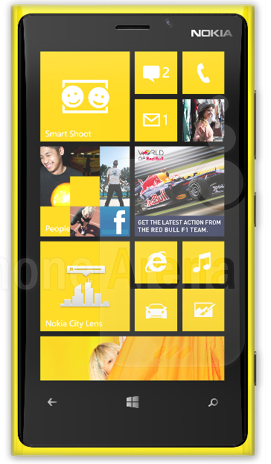
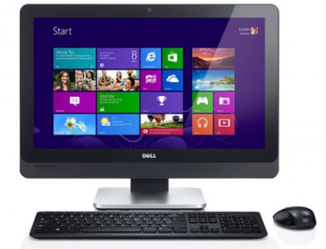
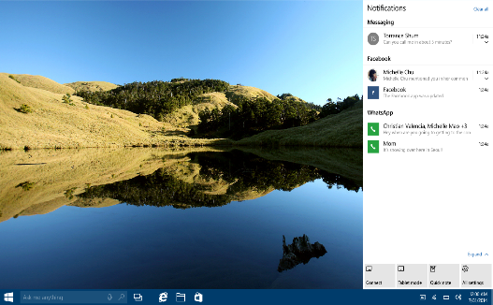


Roaming
Credentials roam across trusted devices
Uses cloud for primary identity
MSA
App
App
AAD
Notes:
Btw – this works for WAB and IE too!

Slide 28
Credential Locker sample
void SaveCredential(string username, string password) { PasswordVault vault = new PasswordVault(); PasswordCredential cred = new PasswordCredential("MyAppResource", username, password); vault.Add(cred); } IReadOnlyList<PasswordCredential> RetrieveCredential(string resource) { PasswordVault vault = new PasswordVault(); return vault.FindAllByResource(resource); }

Slide 29
Sharing State: Other Techniques

Slide 30
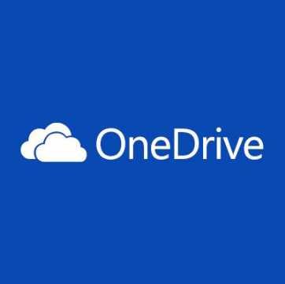
OneDrive Cloud Storage
OneDrive
Accessible cloud storage for personal documents, photos, and files that can be accessed from anywhere.
Best for user owned content.
OneDrive for Business
Secure enterprise grade storage for business documents and files.
Best for business / enterprise owned content.
Depending on your app targeting both is appropriate.

Slide 31
OneDrive Integration choices
Pickers and savers for quick integrations.
Quickly open files from OneDrive and save files back.
Supported for JavaScript, iOS, Android, and Windows Universal apps.
OneDrive API for deeper / robust integrations.
Rich web API that enables all integrations with OneDrive.
First party applications built on this.
Two pathways to light up OneDrive <->app integration
More information: //BUILD/ session 3-734
New OneDrive APIs for Developing Against OneDrive AND OneDrive for Business
http://channel9.msdn.com/Events/Build/2015/3-734

Slide 32
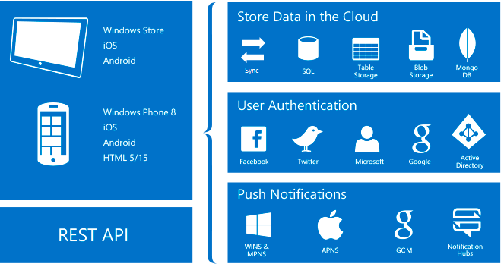
Azure App Service
Notes:
Mobile Apps in Azure App Service offer a highly scalable, globally available mobile application development platform for Enterprise Developers and System Integrators that brings a rich set of capabilities to mobile apps. With Mobile Apps you can:
Build native and cross platform apps - whether you're building native iOS, Android, and Windows apps or cross-platform Xamarin or Cordova (Phonegap) apps, you can take advantage of App Service using native SDKs. Connect to your enterprise systems - with Mobile Apps you can add corporate sign on in minutes, and connect to your enterprise on-premises or cloud resources.
Connect to SaaS APIs easily - with more than 40 SaaS API connectors, you can easily integrate your app with SaaS APIs your enterprise uses today. Want to update account status in both CRM and the billing system? Mobile Apps offer enterprise SaaS APIs at your fingertips.
Build offline-ready apps with sync - make your mobile workforce productive by building apps that work offline and use Mobile Apps to sync data in the background when connectivity is present with any of your enterprise data sources or SaaS APIs.
Push Notifications to millions in seconds - engage your customers with instant push notifications on any device, personalized to their needs, sent when the time is right.

Slide 33
Store Data in the Cloud
Notes:
If you don’t need the full capabilities of Azure App Service, you can just store data in the cloud, but you will have to write your own synchronisation mechanisms.

Slide 34



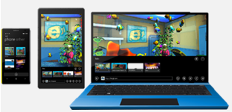
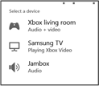


Application Level Connections
Media Element Casting
Remote App Launching
Multi-View Applications
1st
2nd
2nd
ElementCasting APIs
DIAL APIs
ProjectionManager APIs
Very easy, applications can send over content that is playing in the media element.
Applications use DIAL to launch their corresponding application on a remote device.
Create a custom multi-screen experience. Applications can leverage multiple monitors connected to a single Windows Windows 10 device

Slide 35
Create shared mobile experiences whatever the device
Windows 10 supports both MSA and AAD primary identities
Roaming Data APIs provides easy way to sync settings and small files between your app on different devices
PasswordVault securely roams credentials
Use Cloud for larger data synchronization

